Slide 1
Workplace Etiquette
Michelle McCabe-Gray
Regional Director of Business Development
Notes:
The purpose of this training is to help you understand how to efficiently and effectively communicate in a business environment.
In business you want people to take you seriously. The work place is a diverse environment and in order to avoid misunderstanding and be respectful etiquette is necessary.

Slide 2
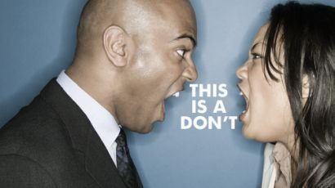
Overview
What does Etiquette Mean?
Differences at the Facility
Sharing Information
Email Etiquette
Effective Communication
Social Media
Workplace Tips

Slide 3
What Does Etiquette Mean?
Etiquette is about presenting yourself with the kind of polish that shows you can be taken seriously
Etiquette in simpler words is defined as good behavior which distinguishes human beings from animals
Socially acceptable ways that we interact with one another and behave in the workplace
Non-negotiables – company policy; anything that makes another person feel uncomfortable/uneasy or afraid

Slide 5
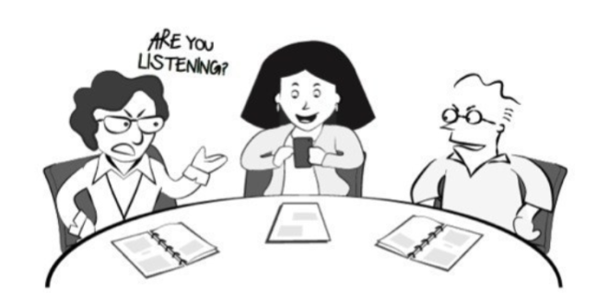
Facility Differences
Know the dos and dont’s of the facility
What are the facility policies
What are tour policies
Dress Codes
Making sure people know you are coming

Slide 6
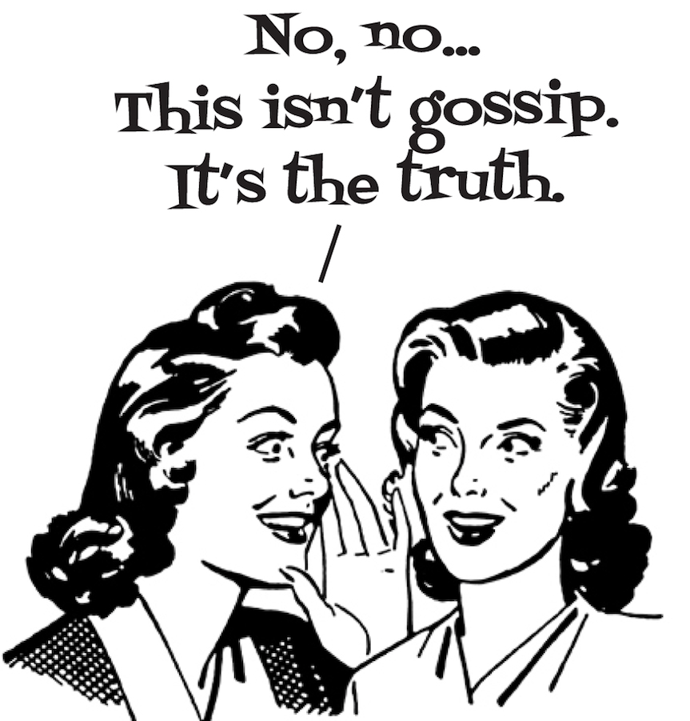
Sharing Information
Worry About Yourself, Not Others
People, Not Packages
Drawing Conclusions on Incomplete Information
You May Feel Forced to Lie
Notes:
Worry About Yourself, Not Others. It can be very demotivating if you're very concerned about everyone else. The best piece of advice is to focus on yourself and your own career path and growth, instead of trying to know what everyone else’s goals are and their goals
People, Not Packages. The main reason to keep your salary to yourself, according to human resources professionals, is because varying levels of experience and skill sets make for an apples-and-oranges, dollars-and-cents comparison; this can be true, even for people with similar job descriptions.
Drawing Conclusions on Incomplete Information. It's nearly impossible to make one-to-one comparisons between employees. Everyone's circumstances are different.
You May Feel Forced to Lie. When it comes to pay, it's hard to know whom to trust. The problem with talking about pay with other individuals is that it may or may not be reliable information. Even if your office buddy is 100 percent truthful, you'll filter the information through the lens of your relationship, which won't help you make good decisions about your position

Slide 7
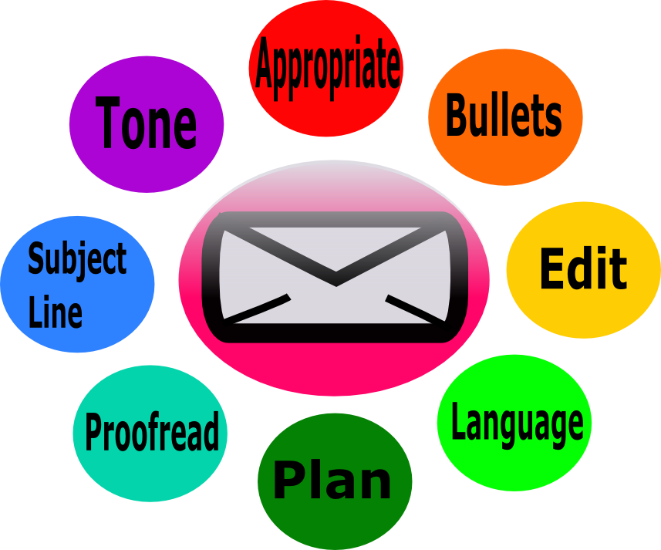
Why Email
Designed to be inexpensive and quick way to communicate
Not originally intended as replacement tool
Keeping track
Understanding when it’s good and bad
Notes:
Today’s world is very fast pace. If you want to be competitive it is important that you are not only professional, but you are efficient. The quicker responses you can deliver the more capable you appear to your customers and coworkers.
By using professional and efficient communication it will protect yourself and your organization from misunderstandings and even possible legal action. Don’t put anything in writing if you are not willing to have it published on the front page of the paper.
Email was designed to be an inexpensive and faster way to communicate. It was not originally intended to be a replacement tool but could you imagine if we still communicated everything via letter? It does give us the opportunity to keep track of what we are sending although we still need to understand when we should use and when we need to rely on other ways of communication

Slide 8
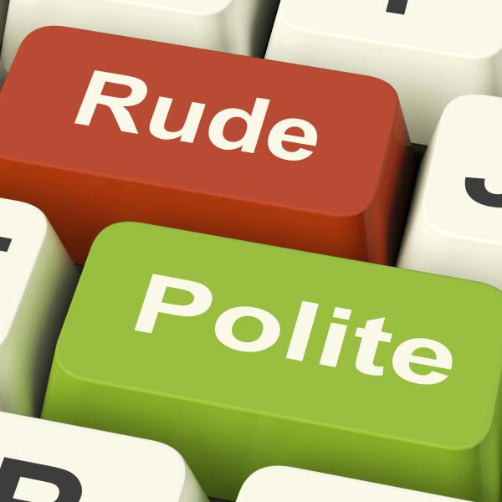
Think Before Writing
24-hour rule
Are you upset or emotional?
Once you send, you can’t take it back
What is the message you are trying to get across?
Will the person on the receiving end understand?
Who will be seeing this email? Directly/Indirectly
Notes:
Once an email is sent, there is no getting it back it is vitally important that we follow the 24hr rule. This is a two part rule. The first part being that you need to respond to emails within 24hrs. Email is generally used when one wants a response in a timely fashion, if you do not have an answer or it will take you long to reply, at least send an email letting the individual know that you received their email and are working on a response.
The second part of the rule is that you want to wait 24hrs to respond to an email if you are angry. It's never a good idea to send an email when you're angry. We've all been guilty of this. In the heat of the moment we type up a literary bomb blast. A message that will reduce the recipient to mush. We even reread it, and we're actually sort of proud at how powerful the wording is. We imagine the recipient opening and cringing as he/she reads our words. Then we send it. Only later, after we calm down, we revisit the message and realize that we dramatically overreacted. But it's too late to do anything now, except apologize and try to mend fences, because as we learned in the previous guideline getting that message back. If you compose an email in anger, wait a predetermined period of time before sending it. If your emotions are legit, then your issue will still be there tomorrow. But in 95% of the cases, you'll be glad you waited and toned things down after you've gain the perspective that can only come with some additional time. We want to make sure that we get across the message we are trying to send but be respectful to the person on the receiving end. One bad email can ruin a professional relationship that you may never be able to get back.

Slide 9
Signature – New Email
Name
Title, Your organization
Office: your-#-here | Cell: your-#-here
Admissions: your-#-here (if relevant)
Fax: your-#-here (if relevant)
Email: lrice@summitbhc.com www.yourwebsite.com
Follow us on: Facebook Twitter LinkedIn
(link your respective social accounts)
Improve the lives we touch
LOGO (in Quip)
Example:
Laura Rice
Marketing Manager, Summit Behavioral Healthcare, LLC
Office: 615-550-3701 | Cell: 205-873-3293
Email: lrice@summitbhc.com
www.yourwebsite.com
Follow us on: Facebook Twitter LinkedIn
Improve the lives we touch

Slide 10
Signature – Forwards/Replies
Name
Title
Office: your-#-here | Cell: your-#-here
Admissions: your-#-here (if relevant)
www.yourwebsite.com
Improve the lives we touch
Example:
Laura Rice
Marketing Manager
Office: 615-550-3701 | Cell: 205-873-3293
www.summitbhc.com
Improve the lives we touch

Slide 11
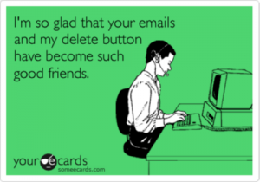
Are one-liners worth it?
No!
We need to tell our audience what we mean
“Beds?”
“Anything open”
Provide some explanation
The more information you provide, the easier and quicker it will be for someone to access care to treatment
Prevent multiple emails
Takes up more time than we think
Notes:
Acknowledge that people have different styles of processing information. This is why it is most critical to communicate in the clearest and most concise manner possible. Information should be delivered systematically and in an easy to understand format.
A paragraph format is not necessarily the most systematic approach or easy to understand data. A paragraph format is more appropriate to use when explaining a situation as if telling a story. You must understand the purpose of your email and that generally guides you to the best format to deliver the information.
Make sure you are clear with your message and it doesn’t cause a million emails back and forth. Sending ‘one-liners’ may cause more time than expected.

Slide 12
Use Short Concise Sentences
The average person won’t read it
Put your questions/ideas in first sentence or paragraph
Rule of thumb
If the information doesn’t fit on a viewing page, it’s probably too long
Use the attachment feature
Notes:
One way to make a message clear and concise is to use bullet points. With the sheer volume of email messages most people receive, there's an inverse relationship between the volume of text, and successfully making the point. Many people will skim through the material possibly losing the message in the process. People appreciate brevity.
Remember, if your objective is to tell the reader what time it is, you don't need to explain how to build a clock!
Organize your thoughts before sending an email. How many times have we gotten an email and we have no clue what the person is trying to say. If you feel your email is going to be longer than a viewing page on a computer (not the phone) than you may want to utilize the attachment feature by creating a word document.

Slide 13
Proofread!
Prevents damage to your image
Your professional image
Summit’s image
Avoids poor grammar/spelling errors
Can leave a bad impressions
Dear auto correct,
“Stop correcting my swear words
you piece of shut”
Notes:
Once you have decided the most effective format to deliver your message it is extremely important that you always double check your work. Its obvious to most of us to use spell check after we've composed our message. You should also make it standard procedure to reread your entire message before sending.
Often times, you'll notice words which have been left out, grammar that's incorrect and worst of all - words witch our spelled right but not used in the right way.
Another reason it is important to reread your message is to make sure that the proper tone is coming through. A great way to insure that the recipient quote unquote hears the message correctly is to read it out loud to yourself. Often times when we are constructing emails we become very technical about the message, when that occurs messages can come off too brash or short, recipients may take offense and once again the message could be lost.

Slide 14
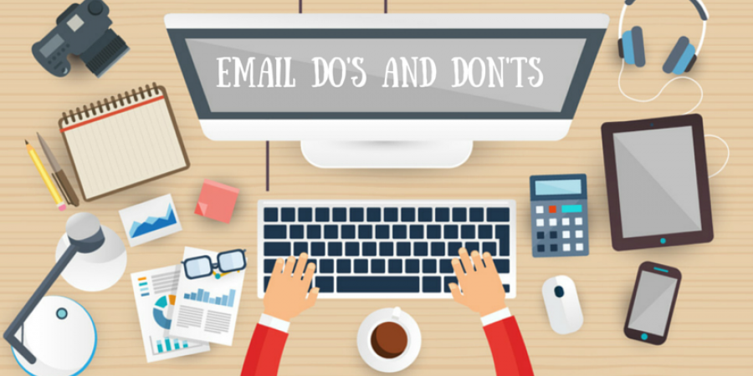
Dos and Don’ts
ARE YOU WRITING IN ALL CAPS?
Quotes at the end of your email
Personal additives
Colors and more colors
Reply to All – Yes or No
Be Professional
You are not texting
Copy only necessary people
Use BCC sparingly
Fill in the subject line last
Avoid Abbreviations
Notes:
We are all guilty of doing, and it is the most important one that we need to be aware of in order to communicate professionally. Anyone who spends a great deal of time online or has a teenager knows you practically need a CIA decoder chart to understand the abbreviations and shortcuts that are popular in email, pagers, text messages and instant messages.
These cutesy short cuts and misspellings are ill advised to use in any corporate context, no matter if your customer is external or internal. Even common shortcuts like LOL (laughing out loud), BRB (be right back), 2 (to) and u r (you are) are simply too casual for most business communication. What's hip to one sender can be read as ignorant and disrespectful by another reader. Since a casual message to a coworker could easily be forwarded, it's best to practice the same high level of professionalism no matter who you're writing to.
The same holds true for the emoticons and using different colors of type. Pictures and rainbow colors can be distracting and make the message hard to read.
Also, remember that not all abbreviations are understood by everyone. In our business we use a great deal of abbreviations like CFL’s, compact fluorescent lights, these abbreviations may not be understood by someone new to the industry or customers, so when communicating by email always type out in full the first time and then abbreviate the rest through out the email, this way no misunderstandings will occur.
Since many email messages go back and forth several times over the course of many weeks, it's important to accurately describe what the reader will find inside. Along with appropriately using reply to insure the continuity of communications, having a specific subject line is just as important.
If your subject line is too generic or poorly worded you run the risk of it not being delivered because it won’t make it through the filters of many spam and anti-spam software. In the world of business not having a message delivered because of a poorly written subject line is not an option.
You may think , what if I leave the subject line blank? That too will not make it past many filters, plus how many of us skip or delete emails that have no subject if they do make it into our mailbox? With the sheer volume of emails that an individual receives throughout their day, the subject line can be the deciding factor on if the email is worth our time to stop and read it. Without a subject you are not even giving your email a fighting chance to be noticed and read.

Slide 15
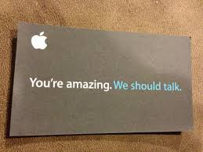
Business Cards
Connection online as well as with cards
Hand someone a card
Get them to as many people as possible
An outdated card doesn’t matter
Notes:
Business cards are antiquated, it's better to connect online. There's no replacement for handing a new contact a business card that represents you and your company in a favorable light. Even though most people can easily find you by looking you up online, a professional business card sends a message of executive achievement.
People won't forget you if you hand them a business card. Don't assume that your phone will start ringing once you pass a box of cards out at your next networking event. Your business card is only an aid to help you make a positive impact and share your contact information. However, it's only one of many tools in your toolbox. Though significant, a business card doesn't do the heavy lifting of building relationships. Your next step is a follow-up phone call, an email or handwritten note, or an invitation for coffee.
An outdated card doesn't matter. No one wants to spend money unnecessarily, but consider the message your card conveys with outdated information. This may appear as though you are not on top of your game, or are trying to scrape by until you absolutely have to pay for new cards. It can also say, "I'm not completely settled into this job." If you are willing to cut corners with a hand scribbled card, how will you handle a new client's business?
"A high-end, oversized or uniquely shaped card will stand out above the rest." Yes, the quality of your business card is an important detail; think back to the last time someone handed you a business card that was printed at home, with perforated edges. You surely noticed the flimsy paper and may have even wondered about how well things were going for their company.

Slide 16
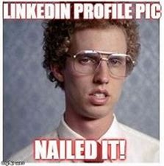
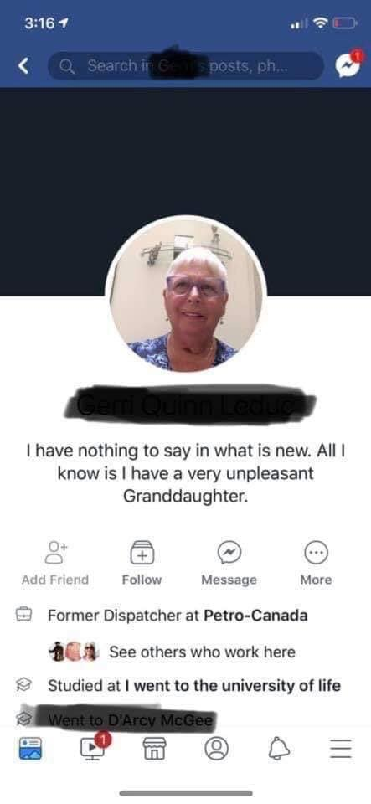
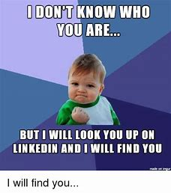
Social Media Etiquette
Differentiate between personal and professional
You don’t have to be “friends” with everyone
What should I put on my professional pages
Don’t get political
Avoid the awkward moments
Tagging people/facilities
How should I be posting my professional information
Me versus the company

Slide 17
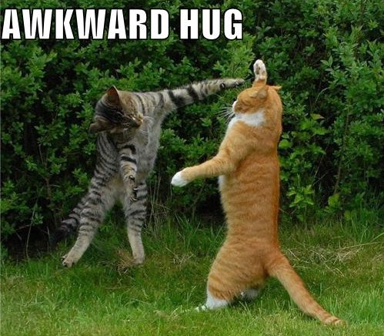
Hugging Etiquette
Always respect another person’s space
Follow the three-second rule
Passing the ‘sniff’ test
Are you a ‘hugger’?
Avoid the awkward moments
Consider frequency and occasion
When in doubt, leave it out
Notes:
Always respect another person's space. An individual's family background, culture, age and gender play a major role in the acceptance or displeasure of a hug. Usually, like a kiss, you can tell from a person's body language if they are willing to receive a hug or not. Follow the three-second rule. Keep the hug short and avoid placing your arm too low around the other person. Longer hugs have a certain connotation and could have negative repercussions if a co-worker's spouse or significant other is present.
Pass the sniff test. If you are sniffling because you are sick, stay home or keep your distance. Additionally, many people don't feel comfortable receiving a hug from someone who has been perspiring or working out. Ask permission when you need or want to share a hug. When you ask permission, the receiver will feel respected and have an opportunity to voice his or her comfort level. Unless you know someone extremely well, it's best to ask, "May I give you a hug?"
Avoid awkward moments. If you greet a group of people and you know some members better than others, give your new acquaintances a handshake first and then follow with hugs for the people you know well. This way you won't have to guess if the new people are pro-huggers or anti-huggers, and you will show consideration for their boundaries. Consider frequency and occasion. A hug and an air kiss may be in order if you haven't seen a co-worker or client for an extended period of time or if you are at a holiday party. A hug is not necessary if you see someone on a regular basis. When in doubt, leave it out. If you're not sure if someone likes to hug, play it safe. You'll stay out of trouble and never go wrong with a handshake.

Slide 18
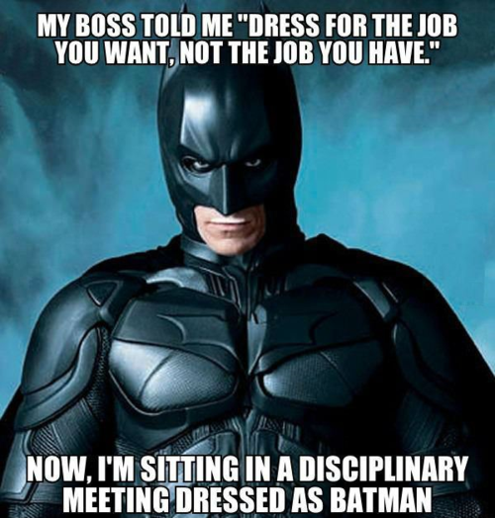
Tips and Suggestions
Always say your full name
Initiate the handshake if you are the host
Proper Dress
Turn Your Gadgets Off
Arrive on Time
Say Thank You
Notes:
Full name - In a business situation, you should use your full name, but you should also pay attention to how others want to be introduced.
If your name is too long or difficult to pronounce, you could consider writing down the pronunciation of your name on a business card and giving it to others.
In today's workplace, the host, regardless of gender, should extend their hand first, she writes. In the United States, the handshake is the business greeting. If you want to be taken seriously, you must shake hands and shake hands correctly.
Clothing, an important form of nonverbal communication, can enhance a person's professional reputation or detract from his or her credibility. You want to send a professional message through your clothing choices. Always find out what the dress code is at the event, meeting, or restaurant you're going to and make sure your attire falls within the guidelines
Turn off your gadgets in meetings. My company's CEO starts every meeting by reminding us to turn our phones face down, close our laptops, and focus only on the meeting. Having the discipline to step away from distractions is refreshing. Of course, this really only works if everyone adheres to it. It's difficult to make that happen, but when everyone is unplugged and focused, meetings are much more productive.
Arrive on time for meetings -- face to face or virtual. If you're the meeting host, on time means at least five minutes early. If you're the guest, on time means on time. It's crazy how often people on both sides of the invitation are late and say nothing about it. If you get held up and know you're going to be delayed, a quick email can keep the person on the other end from feeling stood up.

Slide 19
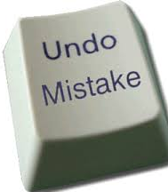
How to “Fix” a Mistake
Remain Calm
Admit the Mistake
Avoid the Urge to “Pass the Buck”
Apologize
Decide Who Needs to Get Involved
Move Forward
Stop Talking About It
Notes:
Remain calm. Resist the urge to leap immediately into damage control. Spend a few minutes determining the most appropriate next steps. One mistake can easily snowball if you proceed in a panic.
Admit the mistake. Waiting and hoping your mistake goes unnoticed is a recipe for disaster if someone discovers it first. A major incident needs to be addressed and dealt with by notifying the proper channels.
Avoid the urge to pass the buck. Even if the screw-up was squarely on the shoulders of someone else, if you are a supervisor and it happened on your watch, it's on you. Identify ways to keep it from reoccurring in the future, and clearly communicate the message to your entire team.
Apologize. However prompt and professional you are in trying to fix your error, an apology is still important. Whether it's to coworkers, a client, or your supervisor, a verbal and authentic apology conveys sincerity and regret over any inconvenience the mistake may have caused. It also displays humility and strength of character.
Decide who needs to get involved. Discussing your mistake with coworkers who are not in a position to fix the problem only wastes valuable time. Strategically choose those who need to know, and request their input and assistance.
Move forward. The perfectionists among us can be easily crushed by a setback. Do what is needed to recover, review the lesson learned, then shake it off and move forward. While a professional blunder is never pleasant, it can be used as a powerful and motivational training tool.
Stop talking about it. It is human nature to drone on and on about a mistake that caused embarrassment to yourself and others. Fight the urge to ruminate, and put your energy into a conversation that will result in a successful outcome. You will definitely be remembered by your last mistake if you keep reminding everyone about it!

